Slide 1


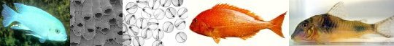
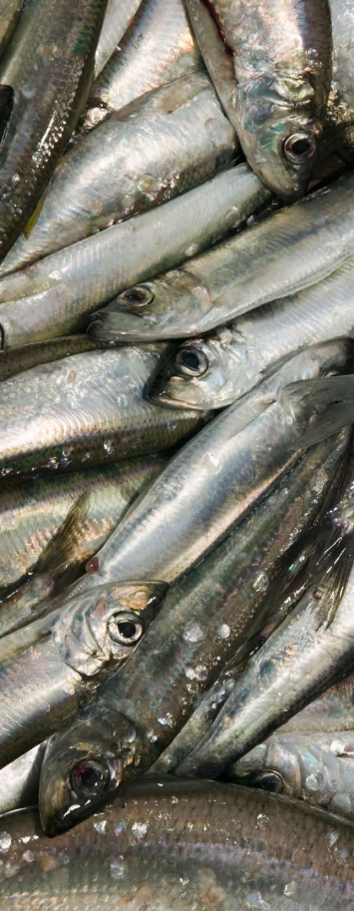
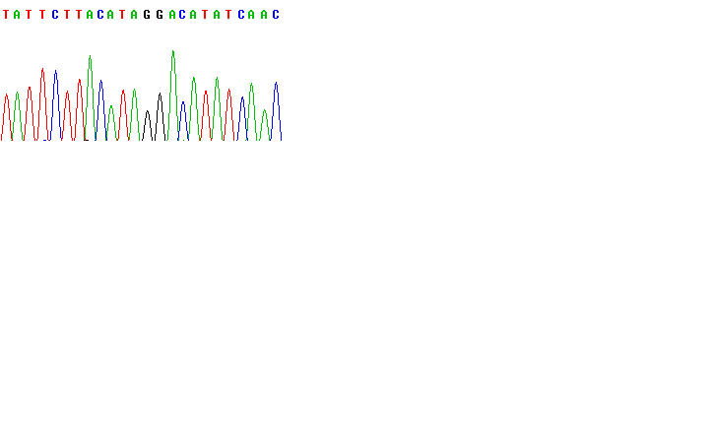

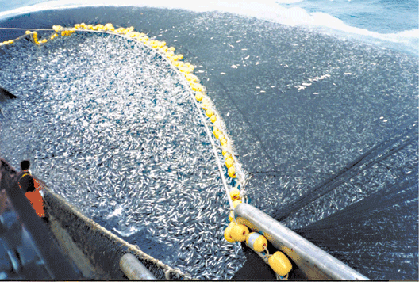
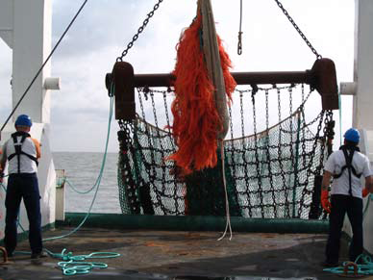
Genetics and quantitative fisheries: Part 1- Conceptual framework
Molecular Ecology and
Fisheries Genetics Laboratory
http://biology.bangor.ac.uk/research/mefgl/
Gary Carvalho, Bangor University
a4a kick-off meeting, JRC, Ispra

Slide 2
Genetics and fisheries: Uneasy bedfellows
All I wanted to know was
how far cod swim!!
CCGTAAGCCCCGTAACCCGTTAACTAAAGGC

Slide 3
Fisheries genetics: objectives
Determine evolutionary consequences of
fishery and culture practices on the stability,
viability, adaptability and biological diversity
of indigenous fish species and populations

Slide 4
Key salient developments of fisheries genetics
Availability of new powerful tools
High throughput nature and standardisation (reference data bases and monitoring)
Biological inferences (significance of population diversity – genomics)
Ecosystem-based approach- (species and population diversity in ecosystems)

Slide 5
Central role of genetics in fisheries biology
Input
(immigration and birth)
Loss
(emigration and mortality)
Quantitative change (abundance)
Qualitative change (frequency and composition of genotypes)
IMPORTANCE OF GENETIC VARIABILITY
Markers as tools and conservation
(recovery and resilience of stocks)

Slide 6
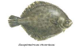
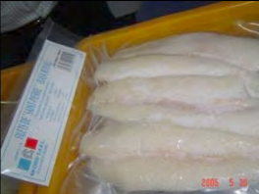
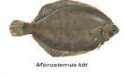
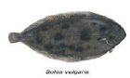
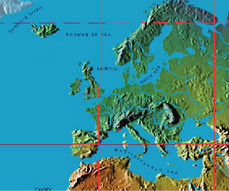
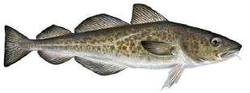
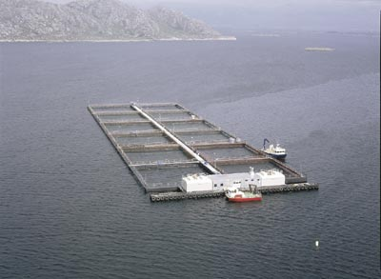
Stock assessment- range of biological levels (input of genetics)
Species
?
Origin assignment
?
Wild versus Cultured
?
Notes:
Species: FishTrace; AnchovyID
I chose flatfish to show that resolution can be quite high
Origin Assignment: FishPopTrace; REMUS; SpraPops; (BOL – Fish-BOL); It has to be stressed that same technology also usable for GSI: genetic stock identification.
Wild versus cultures: FishPopTrace (source of pict: proocean)
6

Slide 7
Genetics and fisheries- context of a4a
Distinct spatial and temporal scales?
Migration among areas?

Slide 8
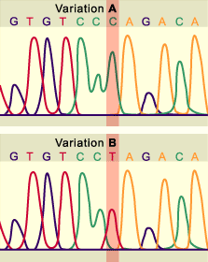

Genetic markers
Broadly three levels of utility in fisheries:
Use as physical “tags” (e.g. stock identification; mixed stock analysis; population assignment, dynamics)
Use to infer biological information (e.g. gene flow, breeding relationships, population size, response to environmental change)
Use in conservation/sustainable management (population diversity “biocomplexity”)

Slide 9
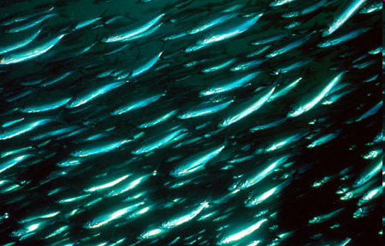

Slide 10
“Classical” marine species
Large population sizes
High fecundity
Pelagic larvae
High larval mortality (survivorship type III)
Wide distribution

Slide 11
Recent changes to paradigm
Increased incidence of subtle but significant genetic structuring (some fine-scale)
Dispersal capacity ≠ gene flow
Temporal stability of structuring
Indications that effective population size (N_{e}) 10⁻⁴ – 10⁻⁵ << census population size (N)
Local adaptation at small spatial scales
Increased potential for rapid genetic change and/or local adaptation
INDEPENDENT DEMOGRAPHICS
DISCRETE YIELD DYNAMICS

Slide 12
Stock assessment
Stock identification and dynamics
Typical mismatch of biological and management units

Slide 13
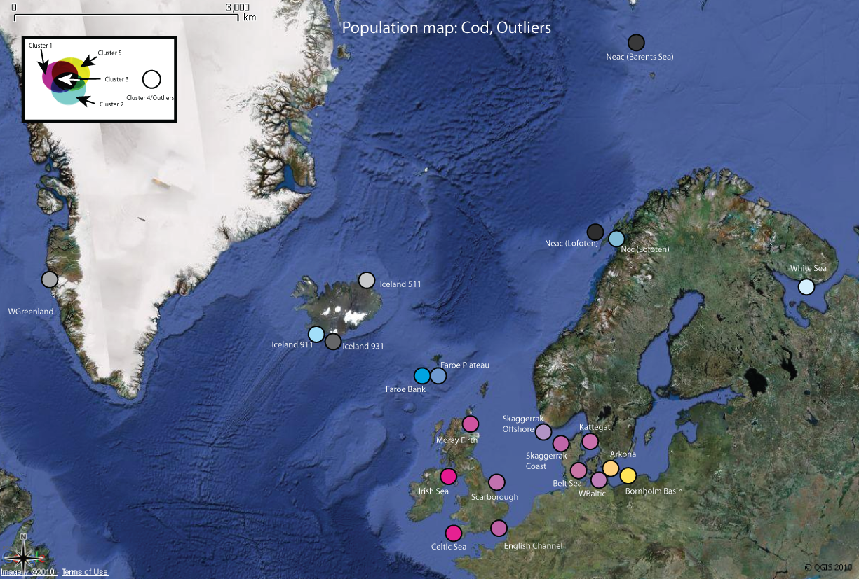

Typical mismatch – cod units using SNPs

Slide 14
Stock assessment
Stock identification and dynamics
Typical mismatch of biological and management units
Stability of identifiable stocks

Slide 15
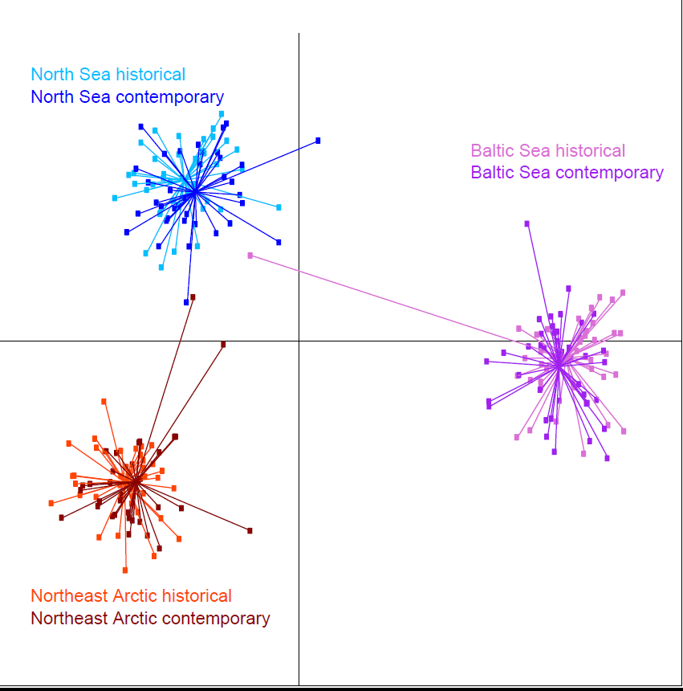
Stability of cod over time

Slide 16
Stock assessment
Stock identification and dynamics
Typical mismatch of biological and management units
Stability of identifiable stocks
Genetic and demographic estimates of exchange between stocks (e.g. 10% exchange and demographic independence vs. limited genetic divergence)

Slide 17
Stock assessment
Stock identification and dynamics
Typical mismatch of biological and management units
Stability of identifiable stocks
Genetic and demographic estimates of exchange between stocks (e.g. 10% exchange and demographic independence vs. limited genetic divergence)
Defining a stock

Slide 18
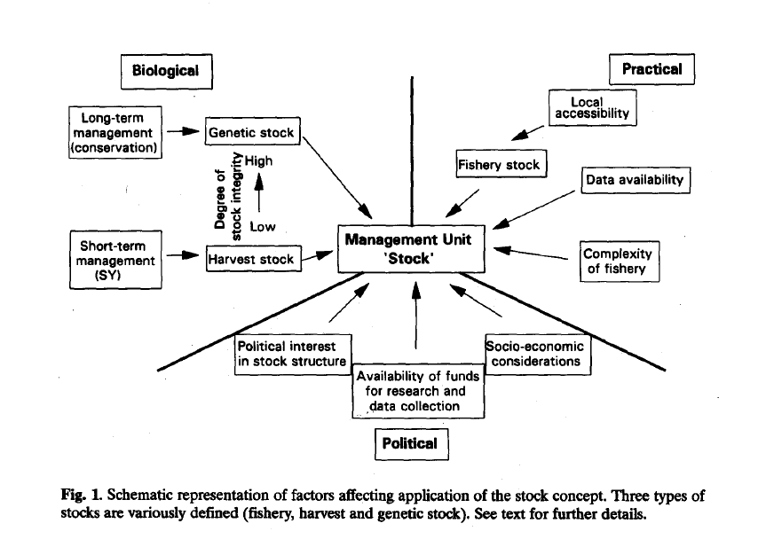
After Carvalho & Hauser, (1994)

Slide 19
Challenges/priorities
Identifying a “common currency” for communication and application (integration of spatial and temporal data)
Biological vs. management units
Defining a stock (practicality vs. reality)
Effective integration and reference data bases
Reconciling divergent time-scales and priorities of interest

Slide 20
Noise in stock assessment
Includes:
Parameter estimation
IUU
Biological variability
Spatial dynamics
Other

Slide 21
1966 Fisheries Research
“Although genetic studies of marine species frequently prove to be interesting in biological and evolutionary terms, stock managers have come to regard their value as being extremely limited”

Slide 22
1966 Fisheries Research
“whilst such debate (value of genetics) is undoubtedly healthy, it is doing little to address the urgent requirement for effective short term stock-based management of marine fisheries- the only realistic option in the present economic climate”

Slide 23
1966 Fisheries Research
“We are indebted to Gary Carvalho for constructive criticism of an early draft of this paper”

Slide 24
Conclusions: uneasy bedfellows or new partnership?
Particular need for:
Increased dialogue
Coherent advisory framework
Increased tangible applications

Slide 25
Conclusions: uneasy bedfellows or new partnership?
Particular need for:
Increased dialogue
Coherent advisory framework
Increased tangible applications
Einar Nielsen
Part 2 -

Slide 26
Thanks to:
FishPopTrace consortium
Dr Lorenz Hauser, Seattle

